Slide 1


HYPER MART DEPARTMENTAL STORE CASHFLOW SYSTEM
NAME: SAIFULLAH ROLL#: 18B-092-CS SEC: SE: B
CS-121 OBJECT ORIENTED PROGRAMMING NSTRUCTOR: DR. LUBAID AHMED

Slide 2

CASHFLOW SYSTEM
Introduction:
Cashflow system is the financial system of the store or organization which takes records of all transactions within the store like Sales, Purchases, Expenses and then calculate that the store is gaining profit or loss and displays cashflow statement in which there are total of all transaction and how much amount is in profit.
Process:
First, we have to add records of all Purchases, Sales, Expenses according to store requirements.
Then it will calculate the total of Purchases, Sales, Expenses,
Displays cashflow statement to represent all transactions total amount ,profit or loss amount and stock

Slide 3

classes
Transaction
Sale
Purchase
Expense
Stock
Cashflow

Slide 4

Transaction class
Transaction class is abstract class.
Having abstract methods:
__Assign_id(): This is a private method to assign unique id to the objects.
Add(): To add records to database
View(): To view all records from data base of same
Delete()
Total()

Slide 5
Sales, purchase and expense class
These classes are child class of Transaction abstract class all 3 classes have same methods with some modifications. So polymorphism overriding method is used to achieve this task.
__Assign_id(): This is a private method to assign unique id to the objects.
Add(): To add records to database
View(): To view all records from data base of same
Delete(): To delete record from database
Total(): To total the amount of all records

Slide 6
Stock class
This class is sub class of two super classes (Sales and Purchases) it take records of stocks sale purchase. The multiple and multilevel inheritance concept is used.
__Assign_id(): This is a private method to assign unique id to the objects.
Add(): To add records to database
View(): To view all records from data base of same
Delete(): To delete record from database
Total(): To total the amount of all records

Slide 7
Cashflow class
This class is for creating cashflow statement.
Profit(): calculating profit or loss
Sales_total(): calculating total sales
Exp_total(): calculation total expense
Pur_total(): calculating purchase total.
Stock_total(): calculating stock total.

Slide 8

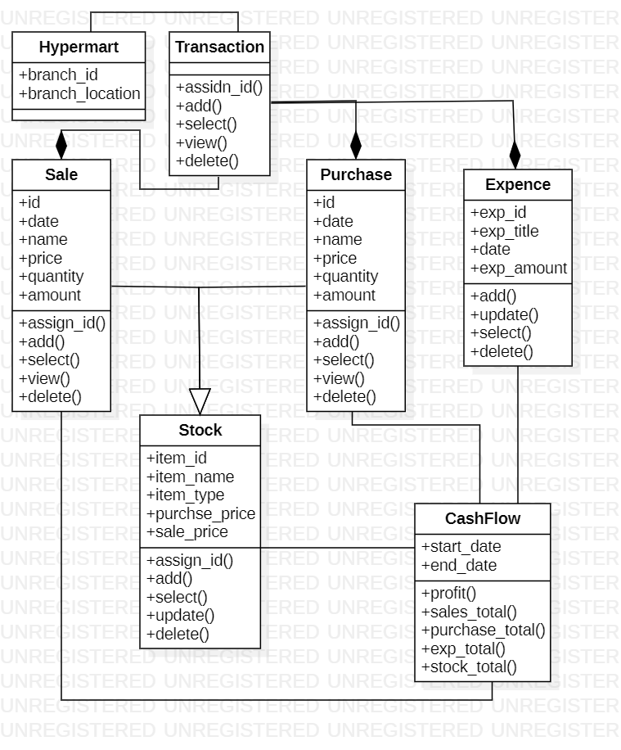
Uml diagrams
Class Diagram

Slide 9
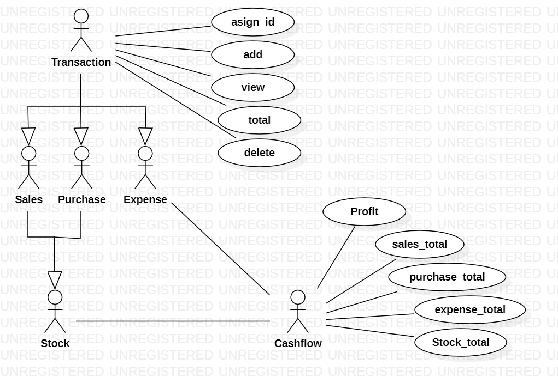
Uml diagram
Use case diagram:

Slide 10
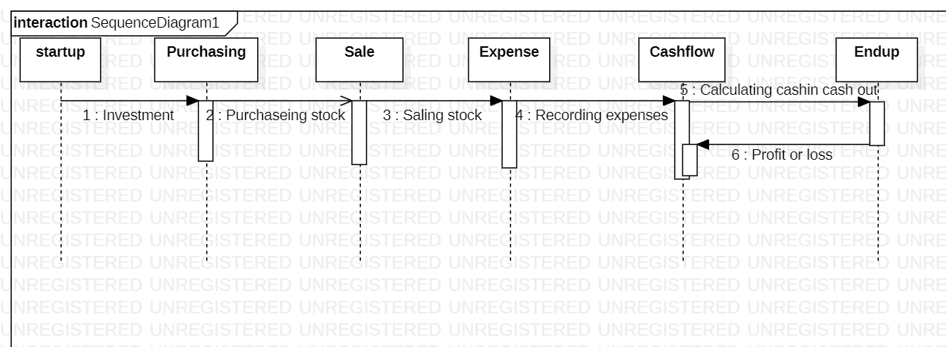
Uml diagram
Sequence Diagram:

Slide 11
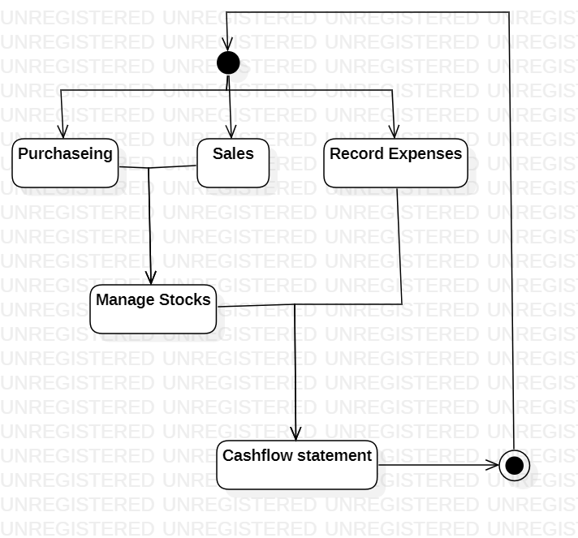
Uml diagram
Activity Diagram:

Slide 12
Tools & techniques
Tools:
Programming Language: Python3
IDE: PyCharm
GUI Module: tkinter
Database: Sqlite3
Modules:
Abc for abstract class
Pillow for images
Sqlite3 for database
Tkinter libraries ( tkcalendar, messagebox,dataentry, ttk)
Techniques:
Object Oriented Analysis
Object Oriented Design
UML Diagrams
Object Oriented Programming
Inheritance
Multiple inheritance
Multi-level inheritance
Abstraction
Polymorphism
Method overriding
Error handling

Slide 13

Algorithms
There are 3 algorithms used in my project
In Assign_id method algorithm is used to assign unique id
Steps:
Convert the default string id into list data type.
Add the list elements into a variable using indexing.
Change the datatype of variable to integer.
Add 1 to variable.
Then check length of variable with datatype string if length is 1 update variable by concatenating two zeros with variable type string (var= ‘0’+’0+’str(var))
if length is 2 update variable by concatenating one zeros with variable type string (var= ’0+’str(var))
if length is 3 update variable to string datatype.
Then update default id with variable
Return variable

Slide 14
Algorithm
2nd algorithm is used in total() method
Steps:
Fetch the amounts of all record from database and store in variable
Then use two for loops to take out the amounts from list and tiples
Make another variable before loops to add all amounts in that variable within the 2nd loop
Return the variable which stored all added amount outside the loop.

Slide 15
Algoithms
3rd algorithm is used in profit method in cashflow class
Steps:
Get sales total from sales class and store in 1st variable.
Get purchase total from purchase class and store in 2nd variable
Get expense total from Expense class and store in 3rd variable
Add purchase total and expense total and store in 4th variable.
Now from Sales total less purchase total and expense total(4th variable) and store in 5th variable.
Return this 5th variable.

Slide 16
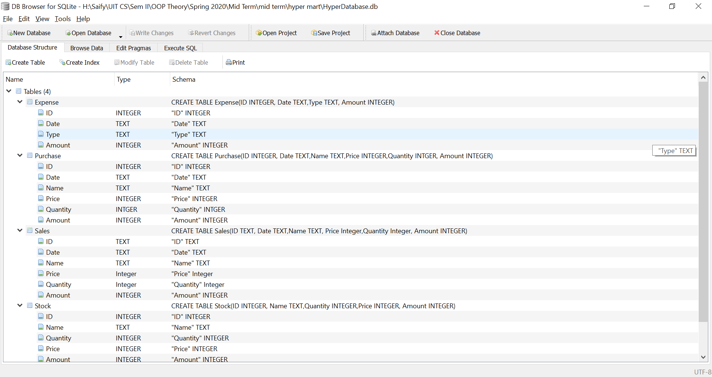
Database

Slide 17
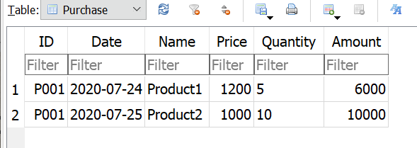
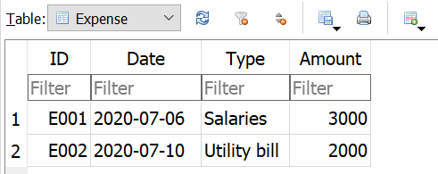
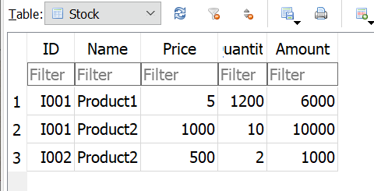
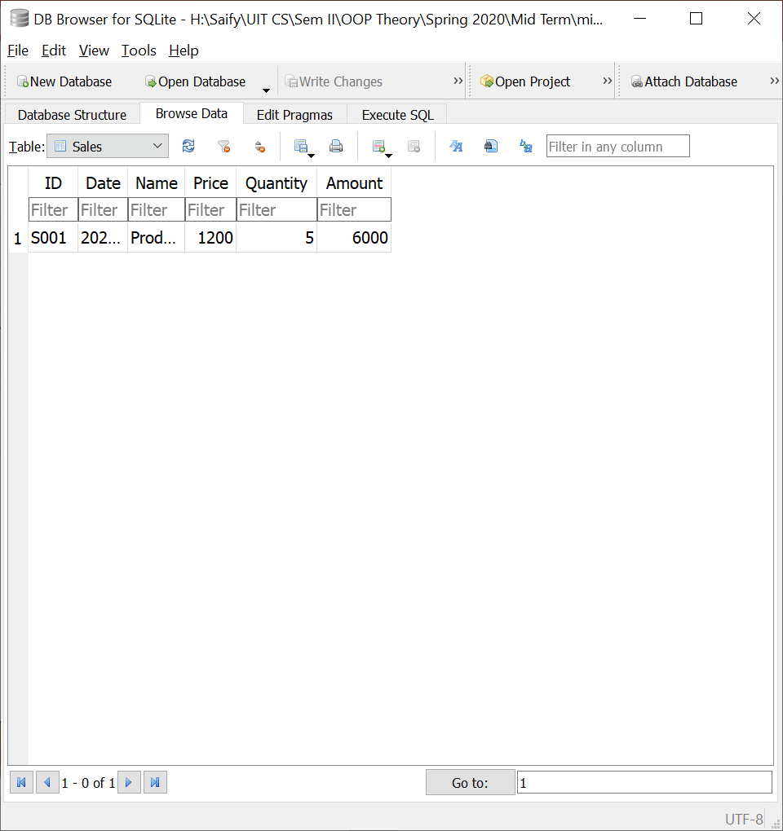
Data in database

Slide 18

Gui Main window

Slide 19
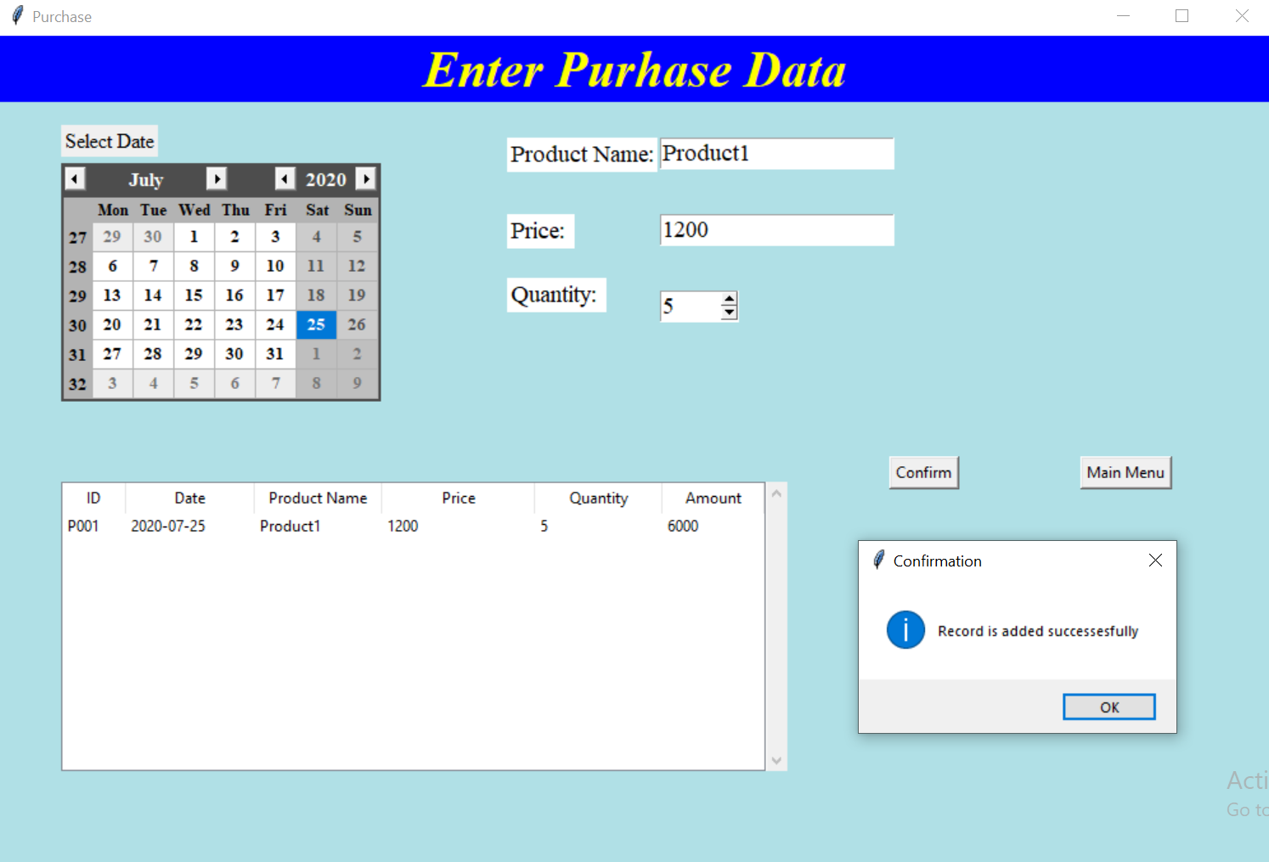
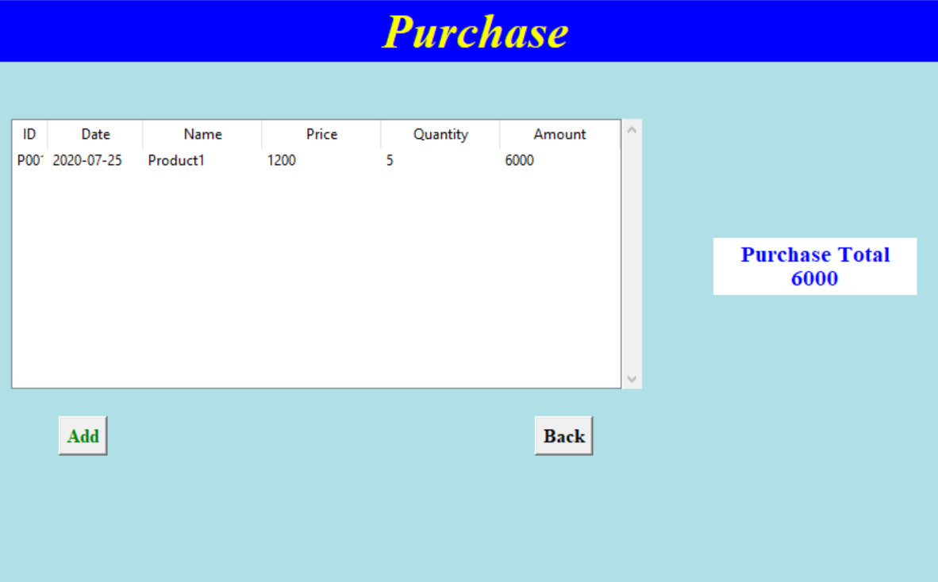
gUI purchase window

Slide 20
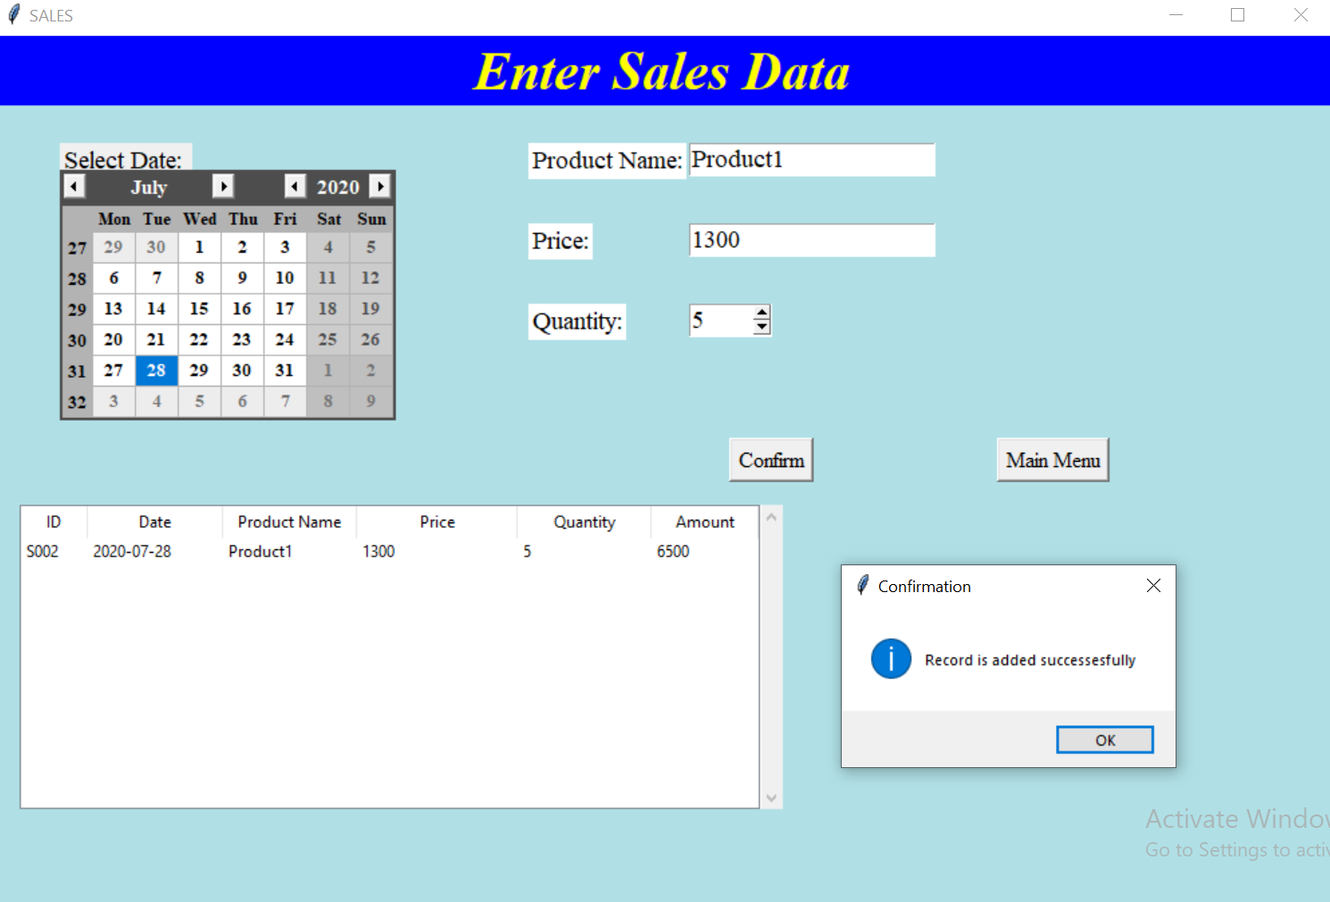
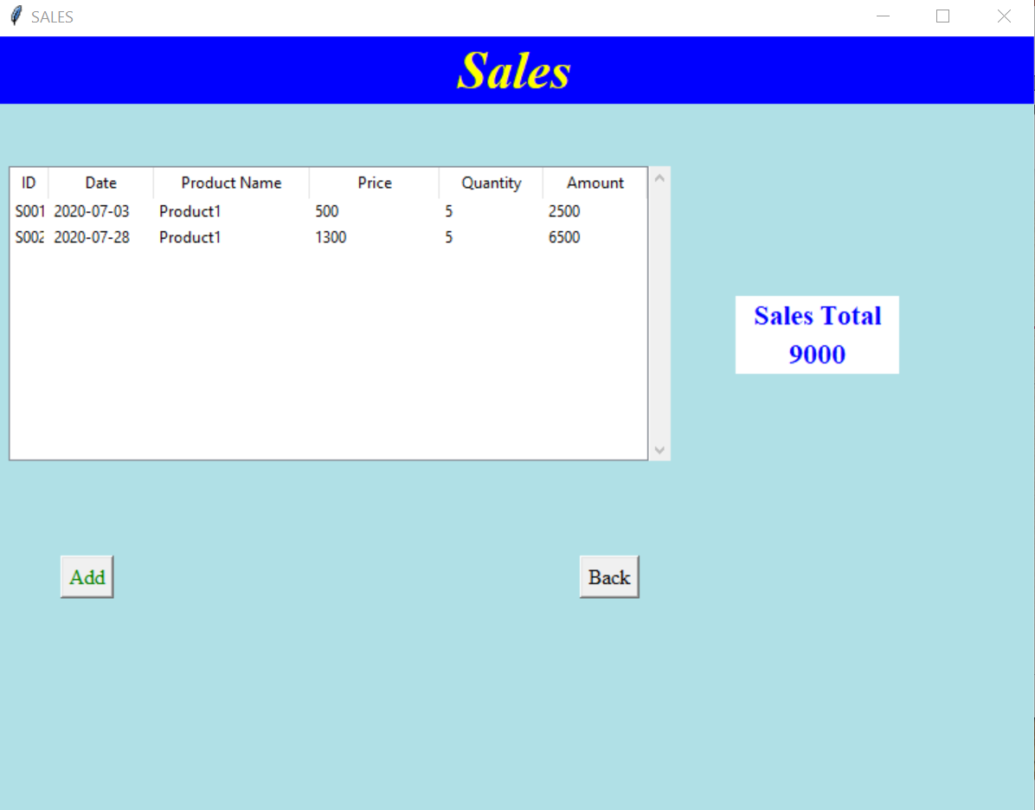
Gui sales window

Slide 21
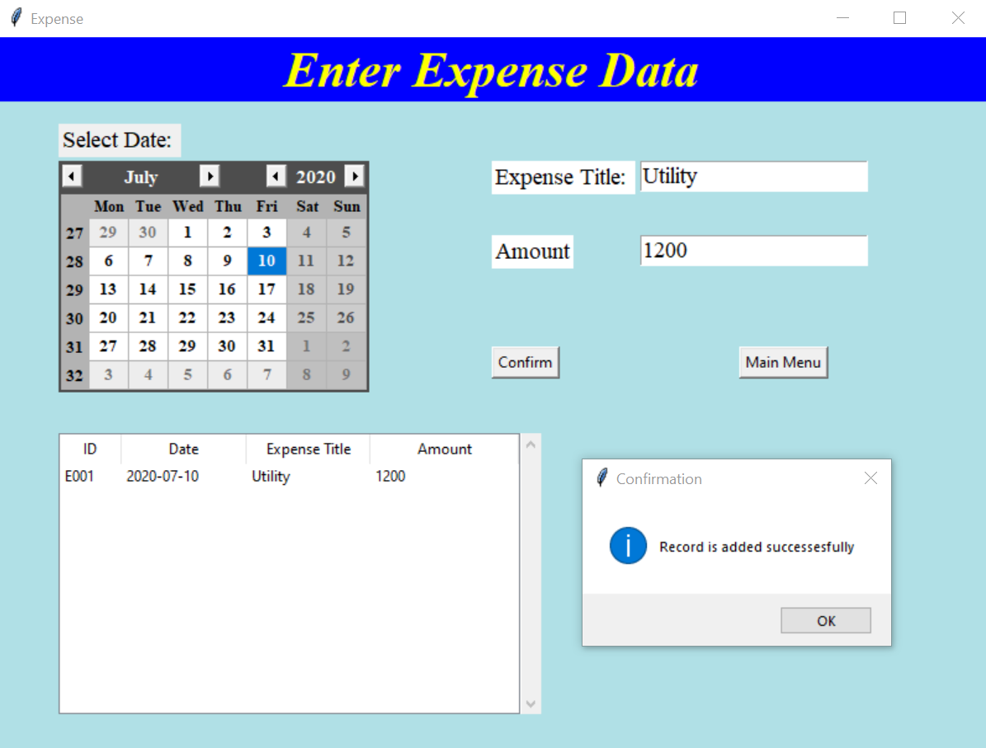
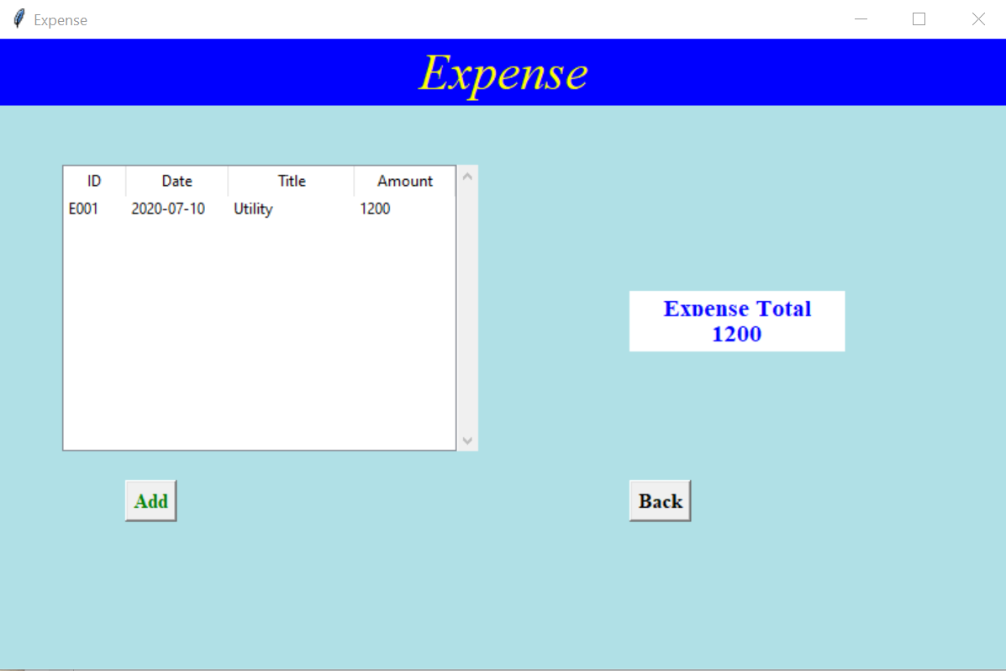
Expense Window

Slide 22
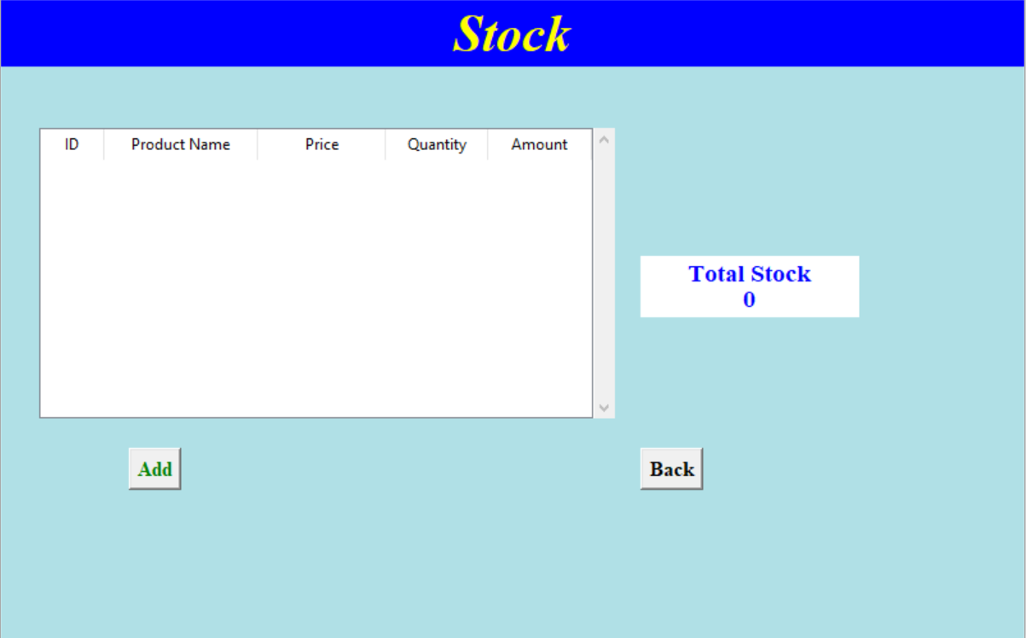
Gui stock window

Slide 23
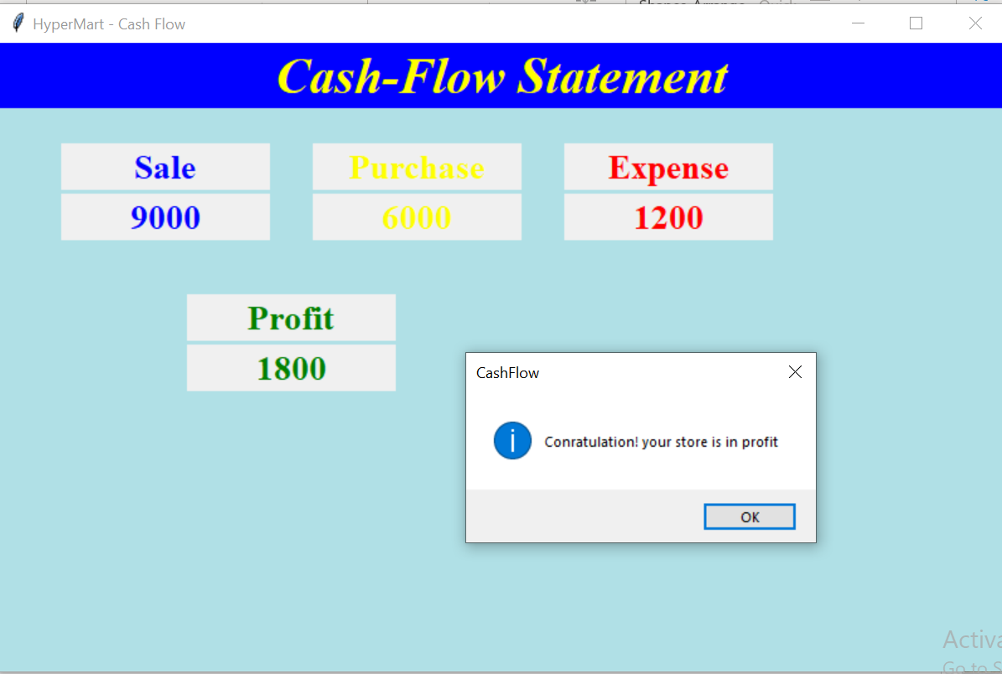
Cashflow statement window

Slide 24
THANK YOU

